Slide 1
MetaCritique
Taylor Bishop

Slide 2

Review aggregator: Movies, Music, T.V. Shows, and Games

Slide 3

View Metascores and product information on your Android device

Slide 4
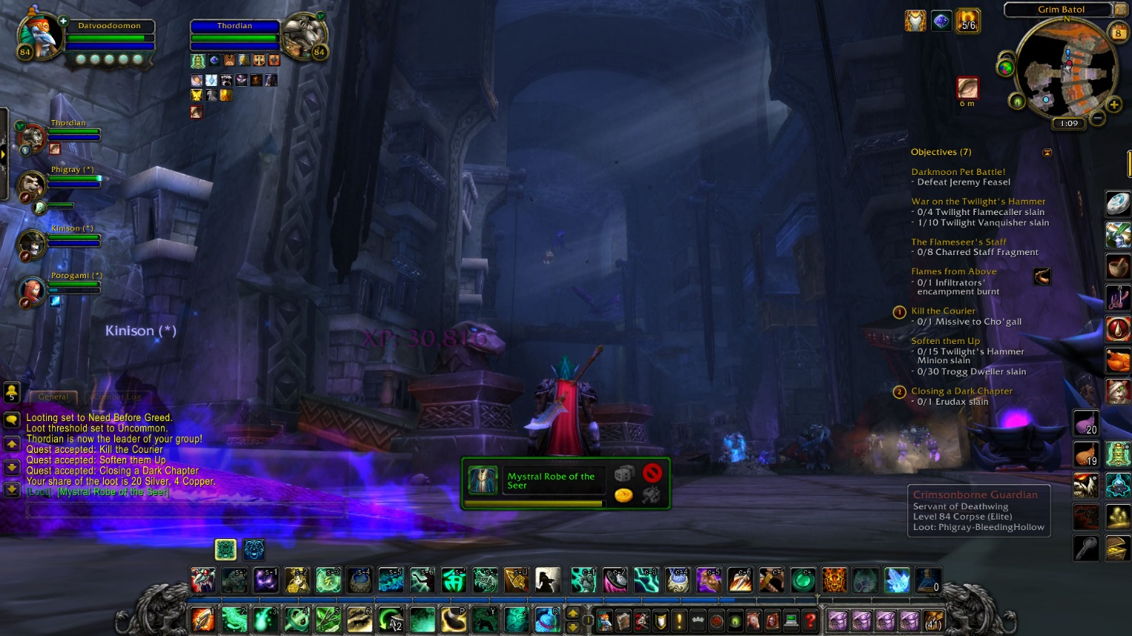
Video Games

Slide 5
Asynchronized
Main crux of the app
Pull source code from two different sources, with the Metacritic page of the product being the main one

Slide 6
Reinvent the Wheel?
Issue with program “knowing” what a user is trying to search for
E.G. user searches “Lord o teh Rings” and meant “Lord of the Rings”
Do I reinvent the wheel and write my own functionality?

Slide 7
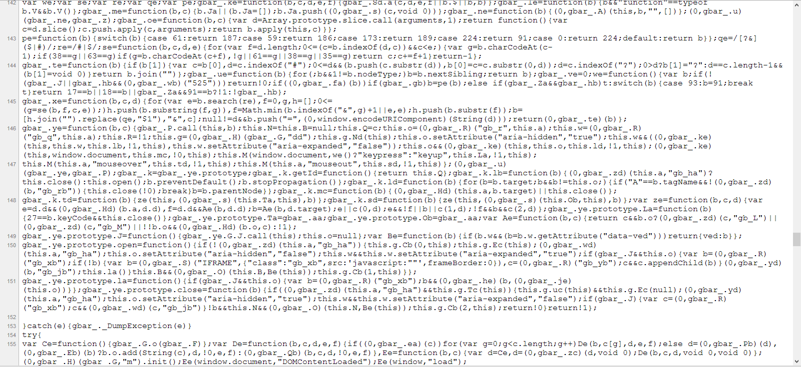
Or turn to Google for help…

Slide 8
Bing Interface
Asynchronous HTTP request to Bing for “[Search term] + metacritic”

Slide 9
Bing Interface
Grab first result, if not to a metacritic page then throw back an error
Works for most all product searches, otherwise user types in a more specific request

Slide 10
Meta Parser
10 components to a result: Title, score, critic reviews link, etc.
Movies and Games use same element tags for their data across all pages

Slide 11
Meta Parser
E.G. “<span class=‘data’ itemprop=‘genre’>” precedes the genre
Search for this in the source code, pull title from there

Slide 12
Front-end > Bing > Metacritic
Front end Bings the search query, using its functionality to guess the most relevant result
Bing pulls the metacritic page
MetaCritique pulls product info from Metacritic page

Slide 13
Added functionality: Progress Bar
Two asynchronous queries: Bing then Metacritic
When crawling Bing, AsyncTask shows a progress bar

Slide 14
hideSoftKeyboard
Hides EditText keyboard when a user taps outside the keyboard
Add touch listener to the main RelativeLayout: if tapped, hide contextual keyboard currently being displayed
Simple, yet effective and sleek

Slide 15
What if Metacritic page is not the first result?
Potential issue, if not handled then it would crash the app

Slide 16
What if Metacritic page is not the first result?
Checks to make sure that Bing result directs to http://www.metacritic.com/ , otherwise throws an error to the user

Slide 17
External links
For critic reviews, user reviews

Slide 18
What’s Next?
Listview the critic and user reviews
Use Bing to a more powerful extent – List relevant products for a search term
E.G. “Lord of the Rings” returns all three movies, all the video games

